Slide 1
Library management SYSTEM
Using Python and MySQL

Slide 2
About library management system

Slide 3

Books play a quintessential role in everyone’s life by introducing them to a world of imagination, providing knowledge of the outside world, improving their reading, writing and speaking skills as well as boosting memory and intelligence.
A LIBRARY is the best and most accessible place to find books. However, libraries have so many volumes and so many people regularly borrow books from them that the need for library management arises.
Therefore, thanks to the very broad curriculum offered by CBSE, which gives us the option to select from a variety of topic combinations, I am fortunate enough to select a subject that interests me: INFORMATICS PRACTICES. But if information is not put to use for someone's advantage, it is of no use. So I argued, why not use my understanding of PYTHON AND MYSQL to develop a resource/facility of LIBRARY MANAGEMENT SYSTEM for the benefit of LIBRARIES who wish to use this System that is very easy to use and operates on wide variety of platforms.

Slide 4
BENEFITS OF LIBRARY MANAGEMENT
S.NO. | BENEFITS
1. | Simple and easy to operate
2. | Increase librarian’s efficiencies
3. | Search, add, update, and view library materials online
4. | Helps to manage library functions constructively
5. | Saves time and reduces overheads
6. | Reduce library’s operating cost
7. | Customized reports for better management
8. | Remove manual processes to issue books and maintain records

Slide 5
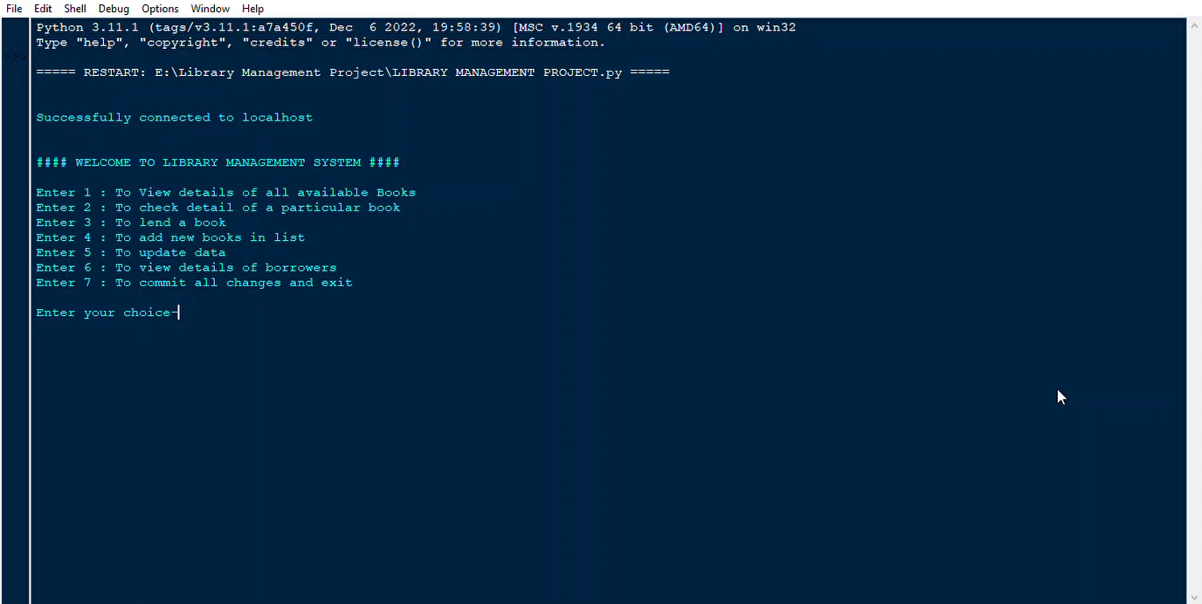
WORKING ANIMANTION

Slide 6
IT + IT = IT INDIAN TALENT +INFORMATION TECHNOLOGY =INDIA TOMORROW
“
”
Sh. Narendra Modi,
Prime Minister, INDIA

Slide 7


MEET OUR CREATORS
MADHAV KAPILA

